Slide 1

Acumatica IOT Integration
Brendan Hennelly – Mark Mynatt – Rochelle Collins
Colleen Kenny Oliver – Alexander Ignatin
Team ETA

Slide 2
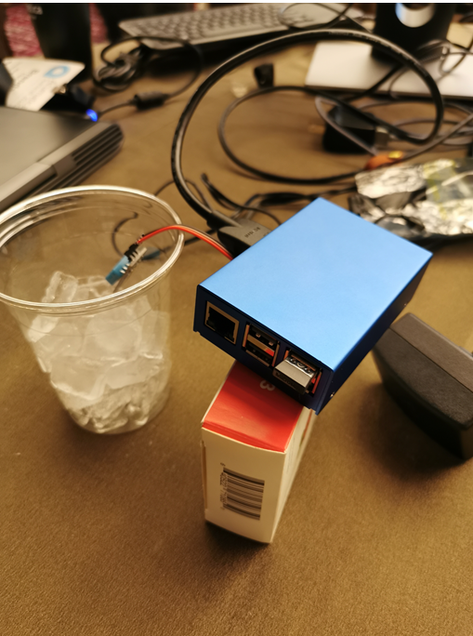
Architecture
Raspberry Pi 3B
DHT11 Temperature Sensor
Windows IOT
UWP App on Windows 10 IOT running on Raspberry Pi
Acumatica

Slide 3
Application
Purpose of the application is to monitor our high value assets to maintain a consistent environment such as pharmaceuticals, wine, & food industries
We created initial Window IOT to Acumatica framework
Opening up the world of Windows IOT to Acumatica
Many different types of Sensors and applications with Acumatica

Slide 4
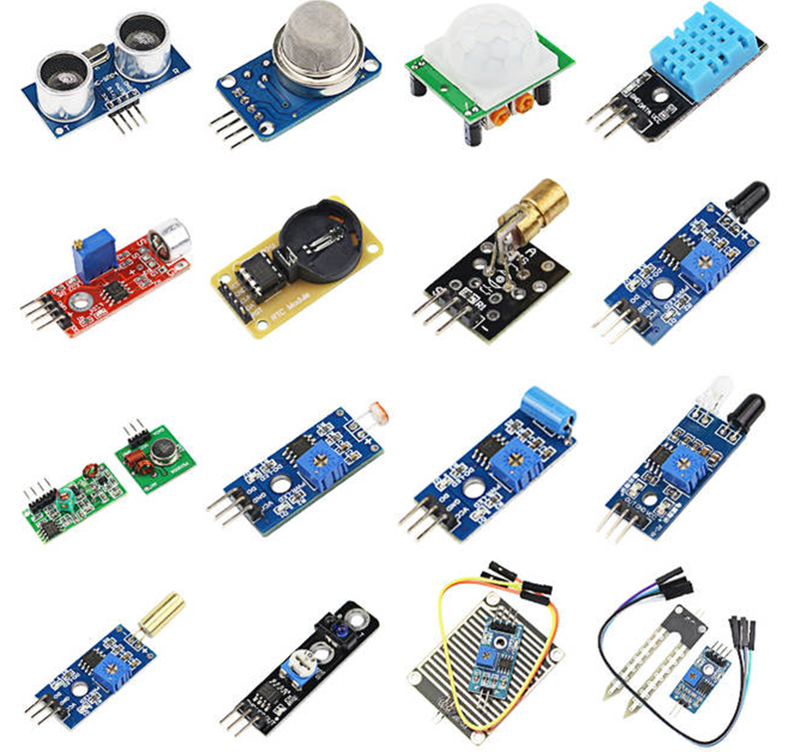
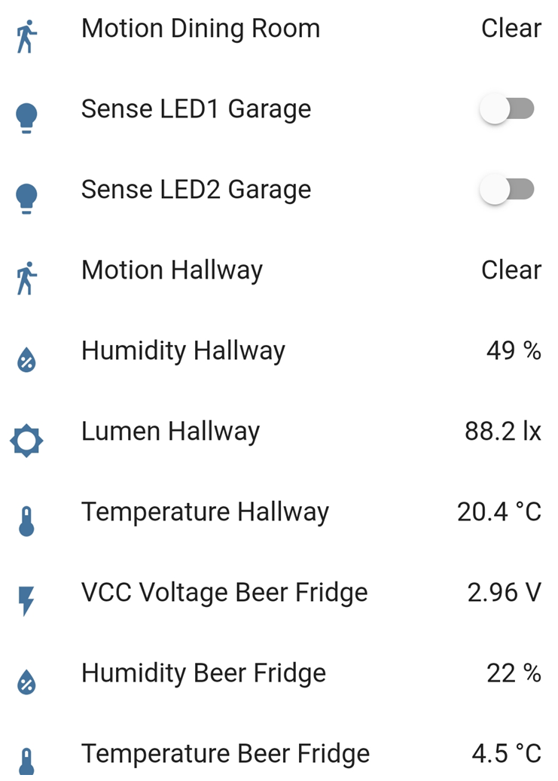
Application

Slide 5
Process
Raspberry Pi Sensor sends Temperature & Humidity to Acumatica
Data is loaded to “Device Temperature” table in the Inventory Module
Generic Inquiry displays logged items that are outside the normal range
Mobile Notification & Business Event were setup to send Push Notification
Product Manager is notified of Temperature Variances

Slide 6
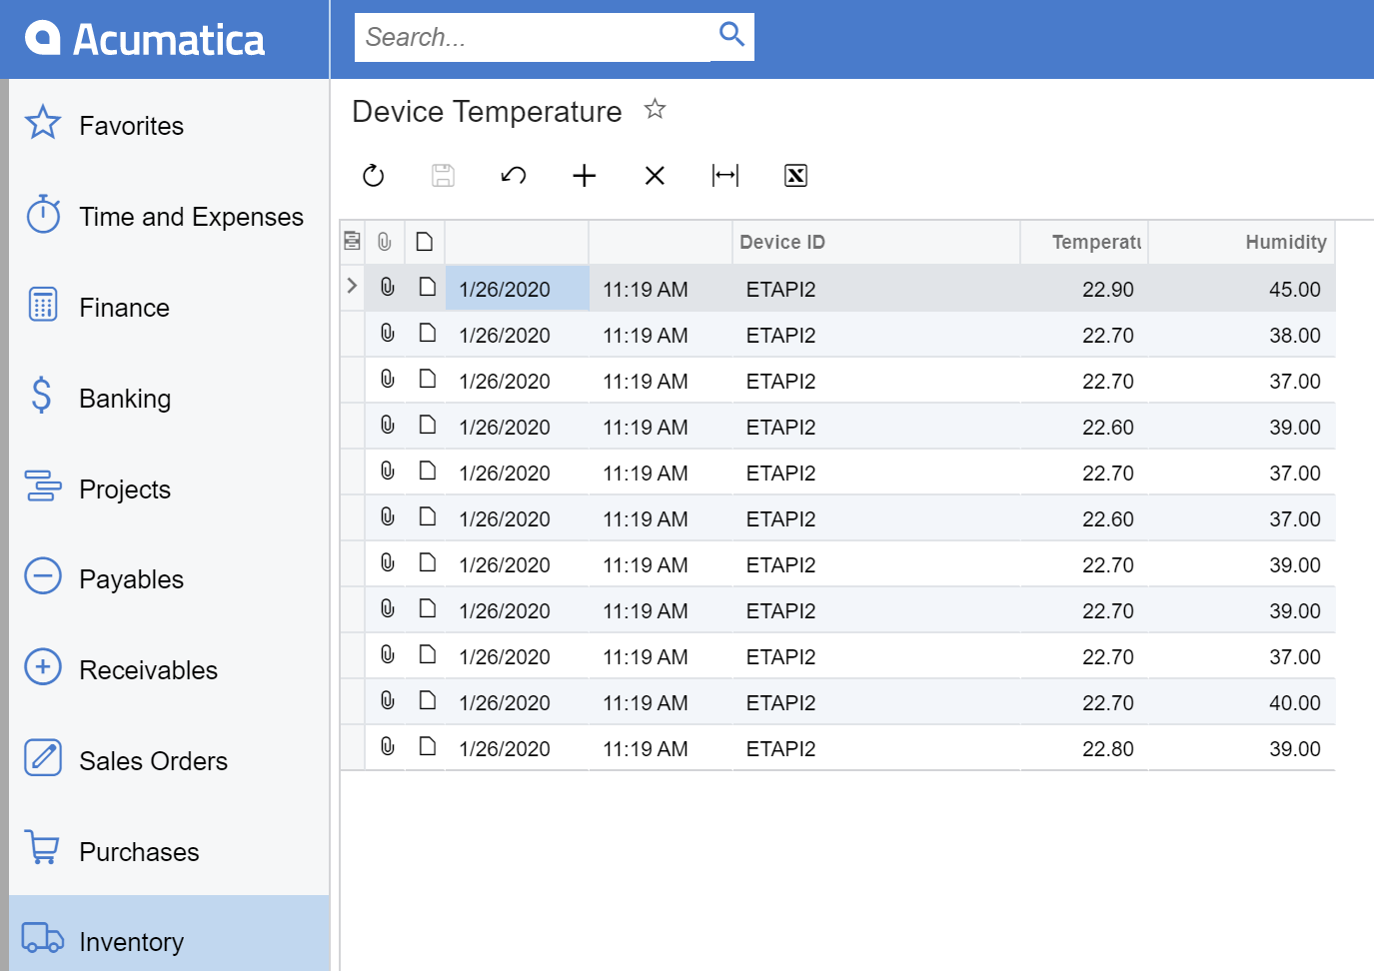

Slide 7
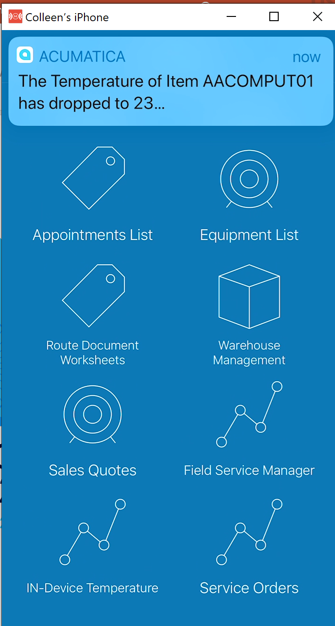

Slide 8
Thank You!

